Slide 1
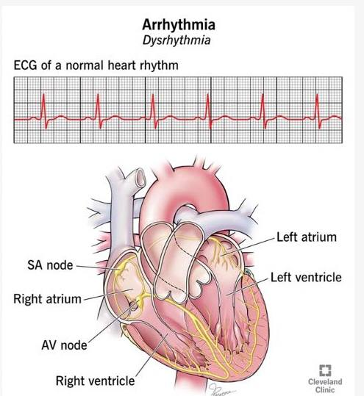
Antiarrhythmics

Slide 2
Antiarrhythmics
Learning objectives:
What Action Potential of cardiac myocyte?
Describe the common types & causes of arrhythmias
Discuss the treatment of common arrhythmias
What are the anti-arrhythmic classes & mechanism of action?

Slide 3
Problem
A 55-year old woman with a history of ischaemic heart disease. She came with palpitation and getting fatigue on walking for a short distance. On examination the pulse was irregular. ECG was done, and the diagnosis of atrial fibrillation was made.
1. How would you treat her condition?
If acute for rhythm control
If chronic persistent for rate control
2. Why did her doctor start her on warfarin?
3. When the pulse regular tachycardia and diagnosis of of supraventricular tachycardia was made.
What are the lines of treatment as an emergency case?
What is the treatment if the condition recurs (paroxysmal SVT)?

Slide 4
Cardiac Arrhythmias
Cardiac arrhythmias are the most common cause of death in patients with a myocardial infarction or terminal heart failure.
Normal sinus rhythm is dependent on generation of an impulse in the normal sinoatrial (SA) node pacemaker and its conduction through the atrial muscle, through the atrioventricular (AV) node, through the Purkinje conduction system, to the ventricular muscle

Slide 5
Action Potential of Cardiac Myocyte
Normal pacemaking and conduction require normal action potentials (dependent on sodium, calcium, and potassium channel activity) under appropriate autonomic control.
Cardiac myocytes are electrically excitable and have a spontaneous, intrinsic rhythm generated by specialized “pacemaker” cells located in the sinoatrial (SA) and atrioventricular (AV) nodes.
Cardiac myocytes also have an unusually long action potential, which can be divided into five phases (0 to 4)
Phase 0: Fast upstroke, Na channels open resulting in a fast inward current of Na.

Slide 6
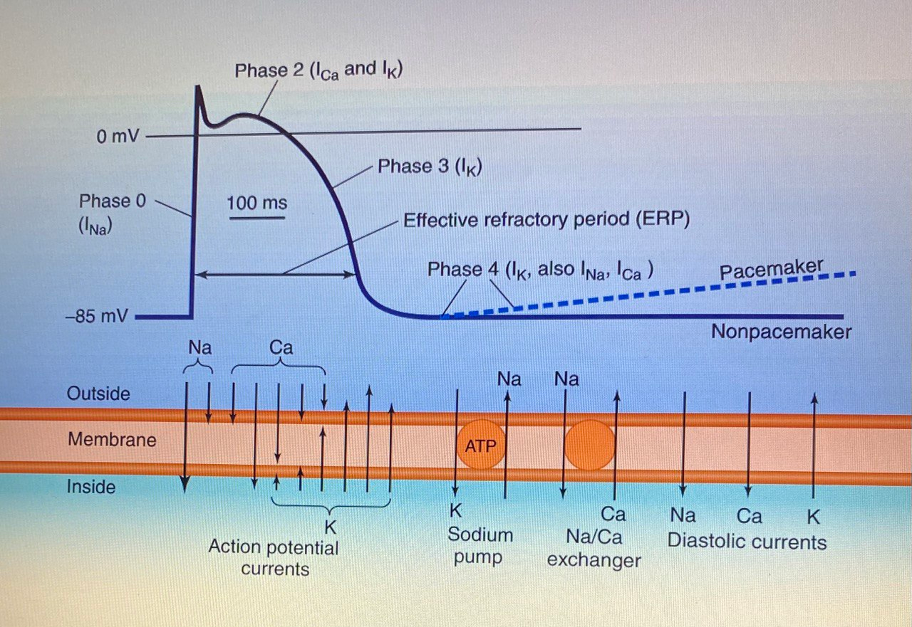
Action Potential of Cardiac Myocyte

Slide 7
Phase 1: Partial repolarization, due to inactivation of Na channels. While K channels rapidly open and close causing a transient outward current of K.
Phase 2: Voltage-gated Ca channels open resulting in a slow inward current of Ca that balances the slow outward leak of K.
Phase 3: Ca channels close. K channels open causing outward current of K that lead to mb repolarization.
Phase 4: a net gain of Na & loss of K is corrected by Na/K ATPase. The spontaneous depolarization automatically brings the cell to the threshold of next action potential.

Slide 8
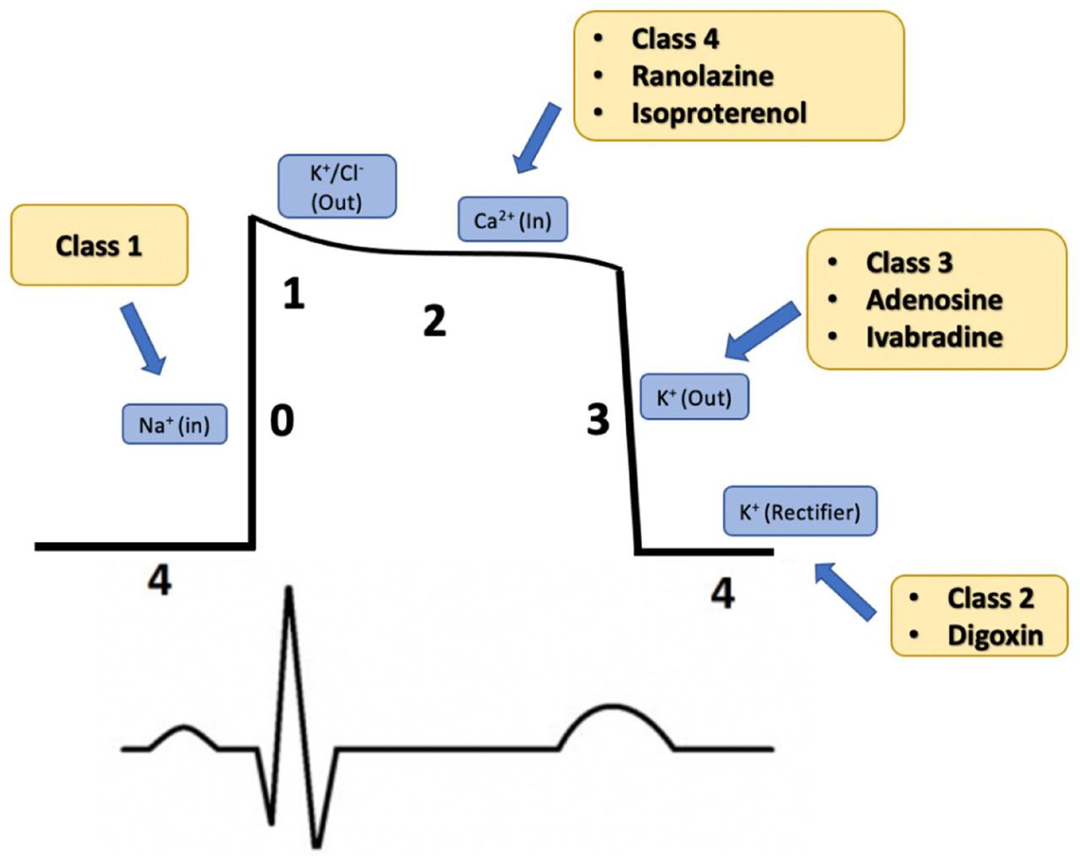

Slide 9
Causes of arrhythmias
1. Abnormal automaticity: SA node shows a faster rate of discharge, and thus, it normally sets contraction for the myocardium. If cardiac sites other than the SA node show enhanced automaticity, they may generate competing stimuli, and arrhythmias may arise.
2. Abnormalities in impulse conduction: A phenomenon called reentry can occur if a unidirectional block caused by myocardial injury or a prolonged refractory period results in an abnormal conduction pathway. Reentry is the most common cause of arrhythmias, and it can occur at any level of the cardiac conduction system.

Slide 10
Common Types of Arrhythmias
A few of the clinically important arrhythmias are atrial flutter, atrial fibrillation (AF), atrioventricular nodal reentry (a common type of supraventricular tachycardia [SVT]), premature ventricular beats (PVBs), ventricular tachycardia (VT), and ventricular fibrillation (VF).
AF is the most common arrhythmia particularly common in older patients. It is often symptomatic and may contribute to worsening heart failure.

Slide 11
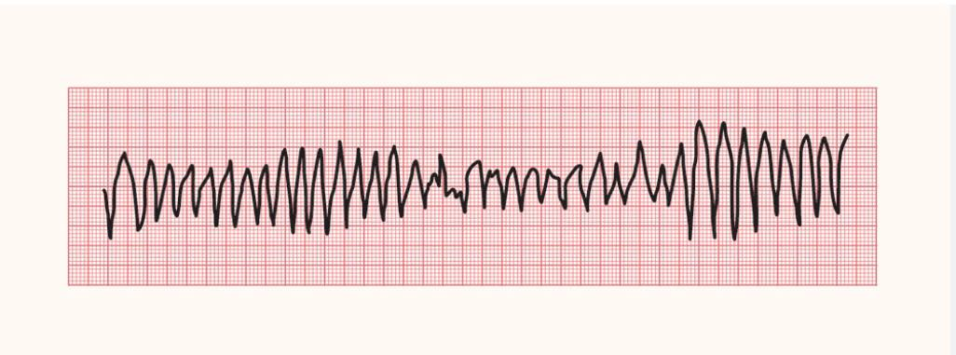
Torsades de pointes is a ventricular arrhythmia of great pharmacologic importance because it is often induced by antiarrhythmic and other drugs that change the shape of the action potential and prolong the QT interval. It has the ECG morphology of a polymorphic ventricular tachycardia.
Other causes: macrolide antibiotics, antipsychotics, hypokalemia, ischemia, and genetic.

Slide 12
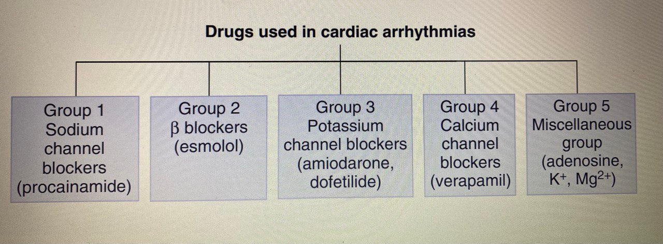

Slide 13
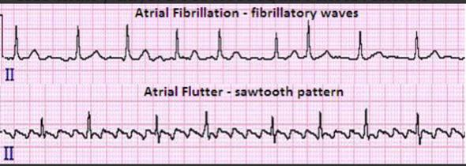
Therapeutic indications for Common Arrhythmias
Atrial fibrillation (AF): irregular tachycardia due to multiple atrial ectopics. It may cause stroke due to blood stagnation in fibrillated atria.
Common drugs: Metoprolol (class 2), Amiodarone (class 3), Diltiazem (class 4), Anticoagulant (warfarin).
Alternative drugs: Digoxin

Slide 14
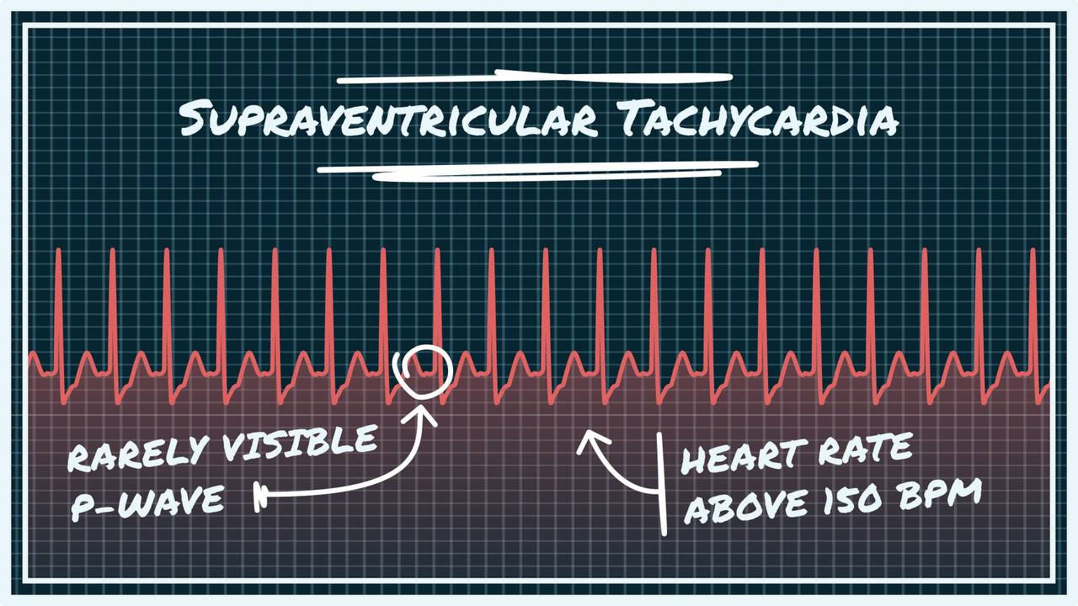
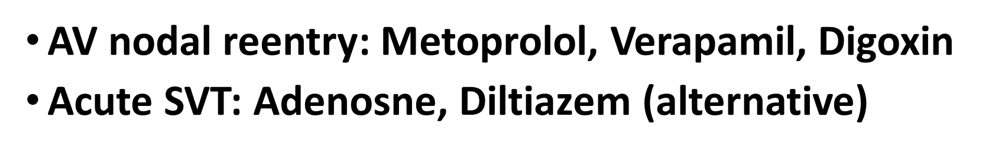
Supraventricular tachycardia (SVT):

Slide 15
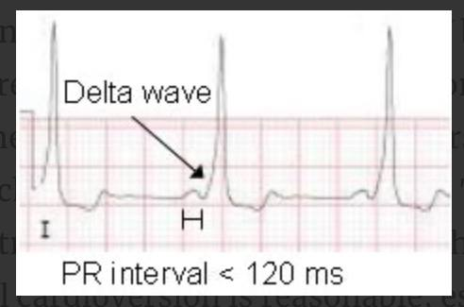
Wolff-Parkinson-White (WPW) Syndrome
Characterized by the presence of an “accessory pathway”. This connects the electrical system of the atria directly to the ventricles, allowing conduction to avoid passing through the AV node.
The combination of WPW and atrial fibrillation can potentially be fatal, especially if AV blocking agents are given (“ABCD” for adenosine or amiodarone, beta-blockers, calcium channel blockers and digoxin).
The medical treatment is procainamide but electrical cardioversion is reasonable, especially with hemodynamic instability.
Catheter ablation is the treatment of choice.

Slide 16
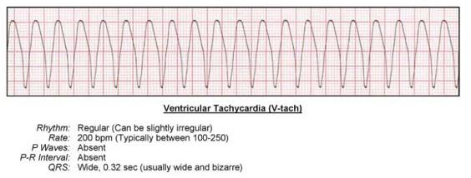
Ventricular Tachycardia (VT)
Common cause of death in MI & HF. COP is impaired.
Implantable cardioverter defibrillator is commonly used.
Acute VT: Amiodarone (Class 3), Lidocaine (Class 1, alternative)
Ventricular fibrillation (not responding to electrical defibrillation): Adrenalin (Epinephrine) & Amiodarone, Lidocaine (alternative)

Slide 17
Classes of antiarrhythmic drugs
Antiarrhythmic drugs are classified into 4 classes besed on their predominant effects on the action potential.
Class I Antiarrhythmic Drugs
Sodium channel blockers. Their use has declined due to their proarrhythmic effects, particularly in patients with reduced left ventricular function and atherosclerotic heart disease.

Slide 18
Class 1 A:
Procainamide: Atrial and ventricular arrhythmias, especially after myocardial infarction. Increased arrhythmias including torsades, hypotension, lupus-like syndrome.
Disopyramide: similar to procainamide but longer duration of action; toxicity includes anticholinergic effects and heart failure
Quinidine: similar to procainamide but greater toxicity, including cinchonism (tinnitus, vertigo, headache), gastrointestinal disturbance, and thrombocytopenia

Slide 19
Class 1B:
Lidocaine: Although amiodarone is the drug of choice for ventricular fibrillation or ventricular tachycardia (VT), lidocaine may be used as an alternative. IV and IM. CNS sedation or excitation
Mexiletine: Mexiletine is used for chronic treatment of ventricular arrhythmias, often in combination with amiodarone. Dyspepsea

Slide 20
Class 1C:
Due to their negative inotropic and proarrhythmic effects, use of these agents is avoided in patients with structural heart disease (left ventricular hypertrophy, heart failure, atherosclerotic heart disease).
Flecainide: useful in the maintenance of sinus rhythm (rhythm control) in atrial flutter or fibrillation in patients without structural heart disease and in treating refractory ventricular arrhythmias.

Slide 21
Class 2: β Blockers
Diminish phase 4 depolarization and, thus, depress automaticity, prolong AV conduction, and decrease heart rate and contractility.
Useful in treating tachyarrhythmias caused by increased sympathetic activity. They are also used for atrial flutter and fibrillation and for AV nodal reentrant tachycardia (SVT). β-blockers prevent life-threatening ventricular arrhythmias following myocardial infarction.
Common SE: bradycardia, hypotension, and fatigue
Metoprolol: is the most widely used β-blocker for the treatment of cardiac arrhythmias. Compared to nonselective β-blockers, such as propranolol, it reduces the risk of bronchospasm.
Esmolol: selective β1-receptor blockade; IV only, 10-min duration. Used in perioperative and thyrotoxicosis arrhythmias

Slide 22
Class 3: K+ channel blockers
These agents prolong the duration of the action potential & prolong the effective refractory period. All class 3 drugs have the potential to induce arrhythmias (prolong QT interval)
Amiodarone: Contains iodine and is related structurally to thyroxine. It has complex effects, showing class 1, 2, 3, and 4 actions, as well as α-blocking activity. Its dominant effect is prolongation of the action potential duration and the refractory period by blocking K+ channels.

Slide 23
Amiodarone is effective in the treatment of severe refractory supraventricular and ventricular tachyarrhythmias. It is the mainstay for rhythm management of atrial fibrillation or flutter.
Amiodarone is unusual in having a prolonged half-life of several weeks. Full clinical effects may not be achieved until months after initiation of treatment, unless loading doses are employed
Pulmonary fibrosis, neuropathy, hepatotoxicity, corneal deposits, optic neuritis, blue-gray skin discoloration, and hypo- or hyperthyroidism.
Despite its adverse effect profile, amiodarone is thought to be the least proarrhythmic of the class 1 & 3 antiarrhythmic drugs.

Slide 24
Sotalol: Class 3 antiarrhythmic agent & nonselective β-blocker. Used for maintenance of sinus rhythm in patients with atrial fibrillation, atrial flutter, or refractory paroxysmal SVT and in the treatment of ventricular arrhythmias.
Since sotalol has β-blocking properties, it is commonly used for these indications in patients with left ventricular hypertrophy or atherosclerotic heart disease.

Slide 25
Class 4: Ca channel blocker
Nondihydropyridine Ca2+ channel blockers verapamil and diltiazem slow conduction in AV node and pacemaker activity.
These agents are more effective against atrial than against ventricular arrhythmias. They are useful in treating reentrant supraventricular tachycardia and in reducing the ventricular rate in atrial flutter and fibrillation. Cardiac depression, constipation, hypotension
Verapamil: AV nodal arrhythmias (SVT), especially in prophylaxis
Diltiazem: Rate control in atrial fibrillation.

Slide 26
Miscellaneous
Adenosine: The drug decreases conduction velocity, prolongs the refractory period, and decreases automaticity in the AV node.
Intravenous adenosine is the drug of choice for converting acute supraventricular tachycardias.
Duration: 10–15 s. Flushing, bronchospasm, chest pain.
Magnesium ion: Possible increase in Na+ /K+ ATPase activity. It is the drug of choice for potentially fatal arrhythmia torsades de pointes and digoxin-induced arrhythmias

Slide 27
Digoxin
Digoxin inhibits the Na+/K+-ATPase pump, ultimately shortening the refractory period in atrial and ventricular myocardial cells while prolonging the effective refractory period and diminishing conduction velocity in the AV node. Digoxin is used to control ventricular response rate in atrial fibrillation and flutter (rate control).
At toxic concentrations, digoxin causes ectopic ventricular beats that may result in VT and fibrillation. Serum concentrations of 1.0 to 2.0 ng/mL are desirable for atrial fibrillation or flutter

Slide 28
MCQ
A 60-year-old woman had a myocardial infarction. Which agent should be used to prevent life-threatening arrhythmias that can occur post myocardial infarction in this patient?
A. Digoxin
B. Flecainide
C. Metoprolol
D. Procainamide
C: Flecainide should be avoided in patients with structural heart disease.

Slide 29
MCQ
A 78-year-old woman has been newly diagnosed with atrial fibrillation. She is not currently having symptoms of palpitations or fatigue. Which is appropriate to initiate for rate control as an outpatient?
A. Amiodarone
B. Esmolol
C. Flecainide
D. Metoprolol
D is an option to control rate. Esmolol is IV only for intra-operative arrythmias. The others are used for rhythm control in patients with atrial fibrillation.

Slide 30
MCQ
Which arrhythmia can be treated with lidocaine?
A. Paroxysmal supraventricular ventricular tachycardia
B. Atrial fibrillation
C. Atrial flutter
D. Ventricular tachycardia
Lidocaine has little effect on atrial or AV nodal tissue; thus, it used for ventricular arrhythmias such as ventricular tachycardia.

Slide 31
MCQ
Which of the following is correct regarding digoxin when used for atrial fibrillation?
Digoxin works by blocking voltage-sensitive calcium channels.
Digoxin is used for rhythm control in patients with atrial fibrillation.
Digoxin increases conduction velocity through the AV node.
Digoxin levels of 1 to 2 ng/mL are desirable in the treatment of atrial fibrillation.
Digoxin is used for rate control in atrial fibrillation (not rhythm control). Digoxin levels between 1 and 2 ng/mL are more likely to exhibit desired effect in atrial fibrillation or flutter.

Slide 32
MCQ
All of the following are adverse effects of amiodarone except:
A. Cinchonism
B. Hypothyroidism
C. Pulmonary fibrosis
D. Blue skin discoloration
Cinchonism (blurred vision, tinnitus, vertigo, psychosis) is known to occur with quinidine. All other options are adverse effects with amiodarone.

Slide 33
MCQ
A clinician would like to initiate a drug for rhythm control of atrial fibrillation. Which of the following coexisting conditions would allow for initiation of flecainide?
A. Hypertension
B. Left ventricular hypertrophy
C. Coronary artery disease
D. Heart failure
Since flecainide can increase the risk of sudden cardiac death in those with a history of structural heart disease, only coexisting hypertension will allow for flecainide initiation. Structural heart disease includes left ventricular hypertrophy, heart failure, and atherosclerotic heart disease.

Slide 34
MCQ
Match the drugs in column A with corresponding mechanisms of action in column B
A
a. Metoprolol
b. Digoxin
c. Verapamil
d. Lidocaine
e. Amiodarone
B
1. Na+/K+ATPase inhibitor
2. Na+ channel blocker
3. K+ channel blocker
4. Ca+2 channel blocker
5. Selective beta blocker

